Slide 1
CSE Collaboration through Software: Improving Productivity and Sustainability
SIAM CSE17
Atlanta, GA
February 28, 2017
Tutorial slides available at: http://bit.ly/siam-cse17-mt3
Lois Curfman McInnes, Argonne National Laboratory

Slide 2

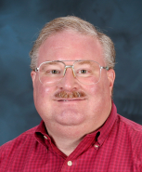
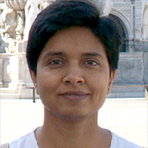
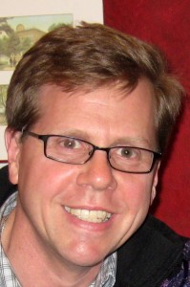
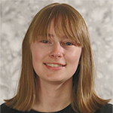
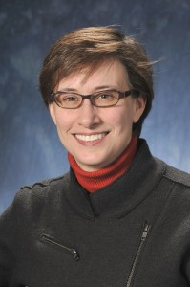



Tutorial instructors
David Bernholdt, ORNL
Anshu Dubey, ANL
Mike Heroux, SNL
Alicia Klinvex, SNL
Lois Curfman McInnes, ANL
Members of the IDEAS Scientific Software Productivity Project: www.ideas-productivity.org
Focus: Increasing CSE software productivity, quality, and sustainability
David Anshu Mike Alicia Lois

Slide 3

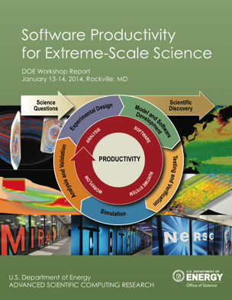
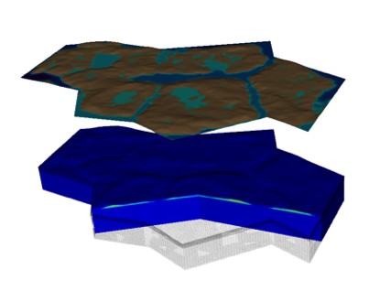
Interoperable Design of Extreme-scale Application Software (IDEAS)
Motivation
Enable increased scientific productivity, realizing the potential of extreme- scale computing, through a new interdisciplinary and agile approach to the scientific software ecosystem.
Impact on Applications & Programs
Terrestrial ecosystem use cases tie IDEAS to modeling and simulation goals in two Science Focus Area (SFA) programs and both Next Generation Ecosystem Experiment (NGEE) programs in DOE Biologic and Environmental Research (BER).
Objectives
Address confluence of trends in hardware and increasing demands for predictive multiscale, multiphysics simulations.
Respond to trend of continuous refactoring with efficient agile software engineering methodologies & improved software design.
Outreach and Community
Approach
ASCR/BER partnership ensures delivery of both crosscutting methodologies and metrics with impact on real application and programs.
Interdisciplinary multi-lab team (ANL, LANL, LBNL, LLNL, ORNL, PNNL, SNL)
ASCR Co-Leads: Mike Heroux (SNL) and Lois Curfman McInnes (ANL)
BER Lead: David Moulton (LANL)
Integration and synergistic advances in three communities deliver scientific productivity; outreach establishes a new holistic perspective for the broader scientific community.
Use Cases: Terrestrial Modeling
Software Productivity for Extreme-Scale Science
Methodologies for Software
Productivity
Extreme-Scale Scientific Software Development Kit (xSDK)
www.ideas-productivity.org
Notes:
Qualitatively new approach based on making productivity the explicit and primary principle guiding our decisions and efforts.
Developing and demonstrating new approaches for producing, using, and supporting scientific software:
- Enhancing interoperability and performance portability of libraries and components
Establishing methodologies that facilitate delivery of software as reusable, interoperable components.
Right: Upper Colorado River System

Slide 4
Tutorial objectives
Overview of best practices in software engineering explicitly tailored for CSE
Why: Increase CSE software quality, sustainability, productivity
Better CSE software > better CSE research > broader CSE impact
Who: Practices relevant for projects of all sizes
emphasis on small teams, e.g., a faculty member and collaborating students
Approach:
Information, examples, exercises, pointers to other resources
Not to prescribe any set of practices as “must use”
Be informative about practices that have worked for some projects
Emphasis on adoption of practices that help productivity rather than put unsustainable burden
Customize as needed for each project

Slide 5

Outline
Part I: 9:10-10:50 am
[10 min] Background, introductions, objectives, setup
[15 min] Why effective software practices are essential for CSE projects
[25 min] Software licensing
[50 min] Effective models, tools, processes, and practices for small teams, including agile workflow management
Interactive exercises: Need Github ID
Part II: 1:30-3:10 pm
[25 min] Reproducibility
[75 min] Scientific software testing
Automated testing and continuous integration
Interactive exercises for code coverage
Access to Linux environment with Git and GNU compiler suite

Slide 6
Tutorial setup: Hands-on
Part I:
Need Github ID
Create a free account at https://github.com/
More Git info: CSE17 tutorial: Version Control with Git, R. LeVeque et al.
https://github.com/uwescience/git-tutorials-siamcse2017
Part II:
Need Git and access to Linux environment with GNU compiler suite

Slide 7
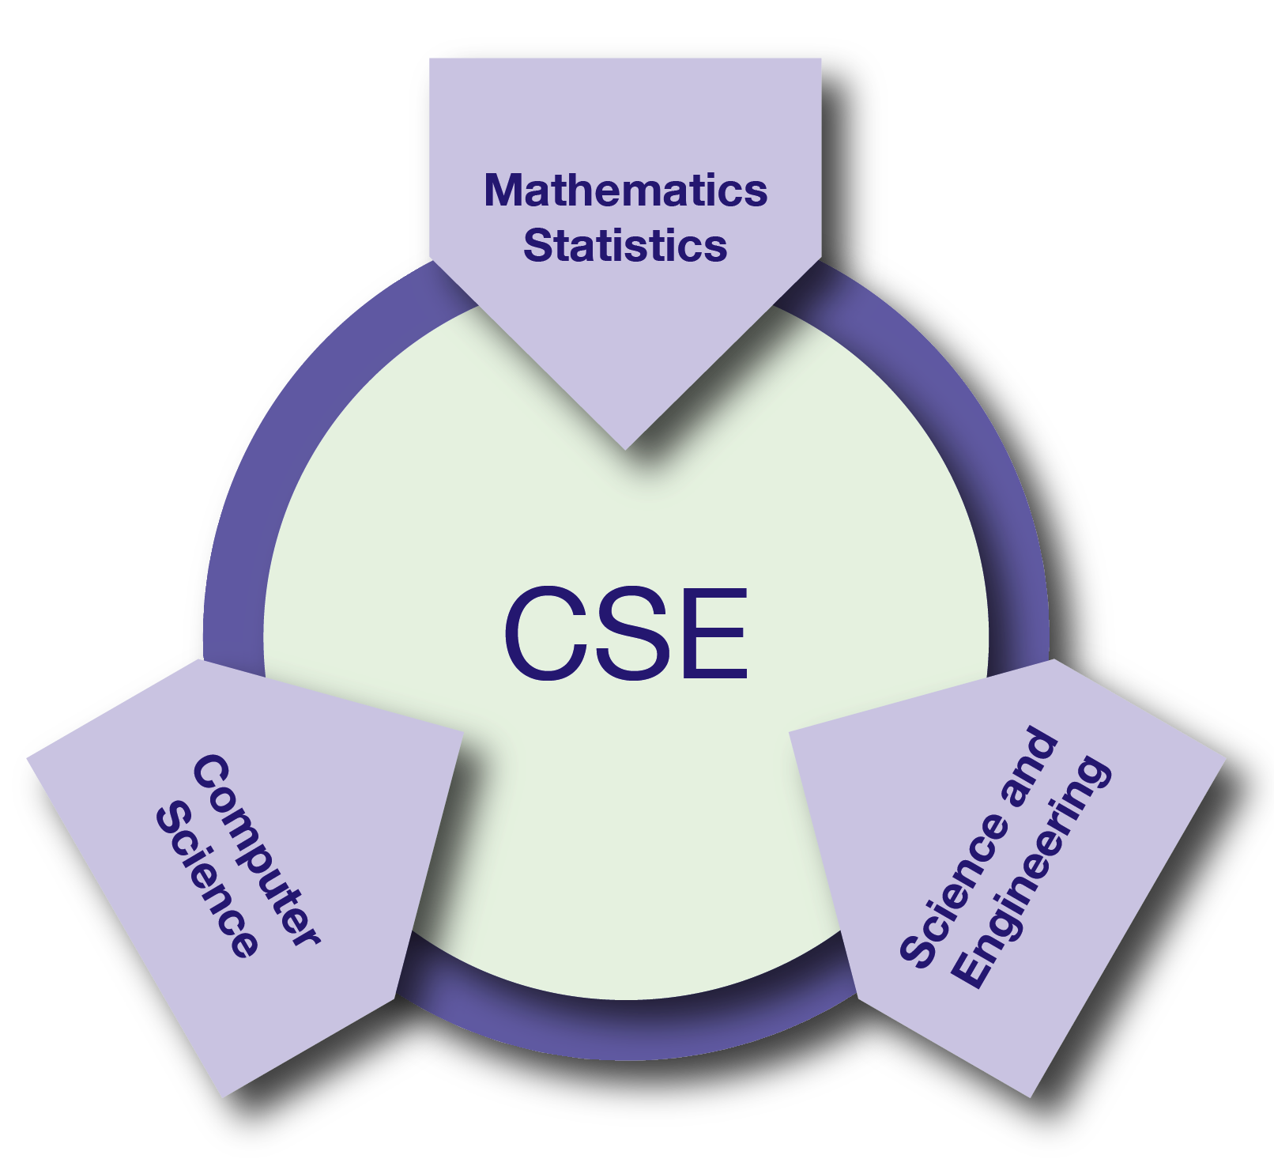
What is CSE?
Computational Science & Engineering (CSE): development and use of computational methods for scientific discovery
all branches of the sciences
engineering and technology
support of decision-making across a spectrum of societally important apps
CSE: essential driver of scientific and technological progress in conjunction with theory and experiment
Reference: Research and Education in Computational Science and Engineering, U. Rüde, K. Willcox, L.C. McInnes, H. De Sterck, et al., Oct 2016, https://arxiv.org/abs/1610.02608

Slide 8
Software is at the core of CSE
Software: foundation of sustained CSE collaboration and scientific progress

Slide 9
Increasing complexity of CSE software
Multiphysics and multiscale modeling
Coupling of data analytics
Disruptive changes in computer hardware
Requires algorithm/code refactoring
Importance of reproducibility
Science: requirements are unfolding, evolving, not fully known a priori
Science through computing is only as good as the software that produces it.

Slide 10
Challenges of CSE software
Technical
All parts of the cycle can be under research
Requirements change throughout the lifecycle as knowledge grows
Verification complicated by floating point representation
Real world is messy, so is the software
Sociological
Competing priorities and incentives
Limited resources
Perception of overhead with deferred benefit
Need for interdisciplinary interactions

Slide 11
Taking stock: Understanding what you want from your CSE software and how to achieve it
Software architecture and process design
Managing complexity and avoiding technical debt (future saving)
Worthwhile to understand trade-offs
Issues to consider
The target of the software
Proof-of-concept
Discard once you’re done with it (or the student/postdoc leaves)
Long-term research tool that successive group members will extend
Others …
How important are performance, scalability, portability to you?
Buy vs. build: can you achieve your goals by contributing to exisiting software, or do you need to start from scratch?
What 3rd-party software are you willing to depend on?
Target should dictate the rigor of the design and software process
Cognizant of resource constraints
Notes:
- Each person/team needs to think critically about their goals in a SWE sense and how much work they’re willing to commit to do it. Most practices can and should be tailored to the needs and style of work of individual teams.
- Map rigor of process to size and needs of the team

Slide 12
Software process for CSE
Baseline
Invest in extensible code design
Most uses need additions and/or customizations
Use version control and automated testing
Institute a rigorous verification and validation regime
Define coding and testing standards
Clear and well defined policies for
Auditing and maintenance
Distribution and contribution
Documentation
Desirable
Provenance and reproducibility
Lifecycle management
Open development and frequent releases

Slide 13
Customize according to your needs
There is no “all or none”
Focus on improving productivity and sustainability rather than purity of process
Danger of being too dismissive too soon
Examine options with as little bias as possible
Fine balance between getting a buy-in from the team and imposing process on them
Many skeptics get converted when they see the benefit
First reaction usually is resistance to change and suspicion of new processes

Slide 14

Resources
Key:
blue text: covered in this tutorial
Black text: pointers to other resources
Individual Productivity:
Personal kanban
Individual learning plans
Collaboration:
Version control
Licensing
Strategies for more effective teams
Documentation
Issue tracking
Planning:
Requirements
Design
Development
Configuration and builds
Legacy code
Refactoring
Individual Productivity
Planning
Collaboration
Software Productivity & Sustainability
Performance:
Performance portability
Software interoperability
High-performance computing
Reliability
Performance
Crosscutting
Reliability:
Testing
Continuous integration testing
Reproducibility
Debugging
Crosscutting:
Projects and organizations
Discussion forums, Q&A sites
Software publishing and citation
Funding sources and programs

Slide 15
IDEAS WhatIs and HowTo docs
Motivation: Software teams have a wide range of levels of maturity in SW engineering practices.
Resources:
‘What Is’ docs: 2-page characterizations of important topics for CSE software projects
‘How To’ docs: brief sketch of best practices
Emphasis on ``bite-sized'' topics enables CSE software teams to consider improvements at a small but impactful scale
Current topics:
What Is CSE Software Productivity?
What Is Software Configuration?
How to Configure Software
What Is Performance Portability?
How to Enable Performance Portability
What Is CSE Software Testing?
What Are Software Testing Practices?
How to Add and Improve Testing in a
CSE Software Project
More topics under development
See: https://ideas-productivity.org/resources/howtos
What Is Good Documentation?
How to Write Good Documentation
What Are Interoperable Software Libraries?
What Is Version Control?
How to Do Version Control with Git
Impact: Provide baseline nomenclature and foundation for next steps in software productivity and software engineering for CSE teams.

Slide 16
Tutorials: Slides and video
Webinar series: Best Practices for HPC Software Developers
Presented May – July 2016
https://ideas-productivity.org/resources/training-events
What All Codes Should Do: Overview of Best Practices in HPC Software Development
Developing, Configuring, Buildling, and Deploying HPC Software
Distributed Version Control and Continuous Integration Testing
Testing and Documenting your Code
How the HPC Environment is Different from the Desktop (and Why)
Basic Performance Analysis and Optimization
Best Practices for I/O on HPC Systems
Argonne Training Program on Extreme-Scale Computing
Session: Software Engineering and Community Codes
Presented Aug 8-9, 2016
https://extremecomputingtraining.anl.gov/agenda-2016
Good Scientific Process Requires Software Engineering Practices
Tools for Controlling Change in Your Software
Introduction to Make and GNU Autotools
Documenting Your Code
Testing Your Code
Software Refactoring

Slide 17
More resources
Software Carpentry: http://software-carpentry.org
Since 1998, Software Carpentry has been teaching researchers in science, engineering, medicine, and related disciplines the computing skills they need to get more done in less time and with less pain.
Lessons: https://software-carpentry.org/lessons/
freely reusable under the Creative Commons Attribution license
Software Sustainability Institute: http://www.software.ac.uk
UK: national facility for cultivating and improving research software to support world-class research
Guides: https://www.software.ac.uk/resources/guides-everything
Computational Science Stack Exchange: SciComp.StackExchange.com
Question and answer site for scientists using computers to solve scientific problems

Slide 18
Outline
Part I: 9:10-10:50 am
[10 min] Background, introductions, objectives, setup
[15 min] Why effective software practices are essential for CSE projects
[25 min] Software licensing
[50 min] Effective models, tools, processes, and practices for small teams, including agile workflow management
Interactive exercises
Part II: 1:30-3:10 pm
[25 min] Reproducibility
[75 min] Scientific software testing
Automated testing and continuous integration
Interactive exercises for code coverage
Access to Linux environment with Git and GNU compiler suite

